Slide 2
Lecture 8: Producer Choice: Firm and Market Supply

Slide 3
Overview of Producer Behavior
Producers in value-chain agriculture aim to maximize their profits by optimizing production and cost decisions.
Profit maximization involves finding the best combination of inputs to produce the desired output level.

Slide 4
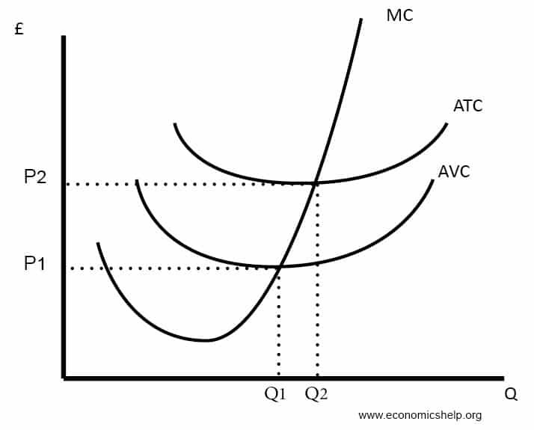
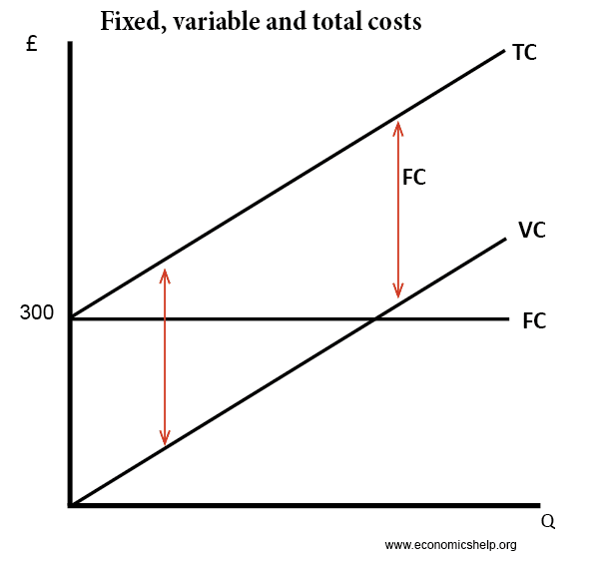
Cost Curves
Cost curves illustrate the relationship between output and cost

Slide 5
Total Revenue (TR) and Total Cost (TC)
Total Revenue (TR) is the total income earned by a firm from selling its products.
It is calculated as the product of the price (P) and the quantity sold (Q): TR = PQ.
Total Cost (TC) is the total expense incurred by a firm to produce a given quantity of output.
It includes fixed costs and variable costs.

Slide 6
Revenue
Revenue curves illustrate the relationship between output and revenue.
Average Revenue (AR), is the revenue per unit of commodity sold. This is the total revenue divided by the output
Marginal Revenue (MR), Marginal revenue is the net addition to the total revenue when one more unit is sold.

Slide 7
Cost Curves
Total Fixed Cost (TFC) – costs independent of output, paying for factory
Marginal cost (MC) – the cost of producing an extra unit of output.
Total variable cost (TVC) = cost involved in producing more units, which in this case is the cost of employing workers.
Average Variable Cost AVC = Total variable cost / quantity produced
Total cost TC = Total variable cost (VC) + total fixed cost (FC)
Average Total Cost ATC = Total cost / quantity

Slide 8
Profit Calculation
Profit (π) is the difference between total revenue and total cost: π = TR - TC.
- Positive profit (π > 0) indicates that the firm is making a profit.
- Negative profit (π < 0) means the firm is facing losses which is also a ‘Loss’

Slide 9
Profit Maximization and Optimization
Producers determine the output level where marginal revenue (MR) equals marginal cost (MC) to maximize profit.
-If MR > MC, increasing output leads to higher profits.
-If MR < MC, reducing output increases profits.

Slide 10
Production Functions
Production functions describe the relationship between inputs and outputs.
In value-chain agriculture, inputs can include labor, land, and capital.
The production function is represented as Q = f(L, K), where Q is the quantity of output, L is labor, and K is capital.

Slide 11
Derivation of Firm and Market Supply Curves
Firm Supply Curve: The firm's supply curve shows the quantity of output a firm is willing to produce and sell at different price levels.
Market Supply Curve: The market supply curve is the horizontal summation of individual firm supply curves.
It shows the total quantity of a good supplied by all producers in the market at various prices.

Slide 12
Relationship with Input and Output Prices
The firm's supply decisions are influenced by input prices (e.g., labor, land, and capital) and output prices (the price at which the firm can sell its product).
If output price increases, firms are motivated to produce more as profit opportunities expand.
If input prices increase, firms may reduce production to control costs.

Slide 13
Exercise 1:
Consider a firm in the value chain agriculture sector that produces strawberries. The production function for strawberries is given as follows: Q = 20√L, where Q is the quantity of strawberries produced and L is the amount of labor input.
Calculate the quantity of strawberries produced when the firm employs 25 units of labor.

Slide 14
Exercise 2:
The total cost (TC) function for the strawberry firm is given by: TC = 5L + 100, where L is the amount of labor input.
Calculate the total cost of producing strawberries when the firm employs 30 units of labor.

Slide 15
Exercise 3:
The price of strawberries is MWK8 per unit, and the firm's total revenue (TR) function is given by: TR = 8Q, where Q is the quantity of strawberries produced.
Calculate the total revenue when the firm produces 50 units of strawberries.

Slide 16
Exercise 4:
Using the information from Exercises 2 and 3, calculate the profit (π) earned by the firm when it employs 30 units of labor and produces 50 units of strawberries.

Slide 17
Exercise 5:
A strawberry producer faces the following cost schedule:
Calculate the firm's average cost (AC) at each quantity level
Calculate the firm's marginal cost (MC) at each quantity level
Quantity (Q) | Total Cost (TC)(MWK)
0 | 50
10 | 120
20 | 190
30 | 260
40 | 330
50 | 400

Slide 18
Case Study: The Tomato Industry in Malawi
The tomato industry in Malawi consists of small-scale farmers who grow tomatoes for both local consumption and export. The market for tomatoes is competitive, with many farmers producing similar quality tomatoes. However, some farmers face higher production costs due to limited access to resources like irrigation and fertilizers.
Analyze the market structure of the tomato industry in Malawi. What are the characteristics of a competitive market, and how do they apply to this industry?
Discuss the factors that influence the supply decisions of tomato farmers. How do input prices and output prices affect their production choices?
How can farmers optimize their profits in the tomato industry? Explain the concept of profit maximization and how it is applied in the context of tomato production.

